Slide 1



WELCOME
TWO DAYS
INTERNATIONAL CONFERENCE on
“Recent Challenges and Innovations in Engineering Science and Technology”
9th and 10th MAY 2025
K.S. INSTITUTE OF TECHNOLOGY
Bangalore – 560 109, India
A Article Presentation on
ReBottle Rewards: Plastic Management and Reward System
Paper Id: 323
Presenting Peers:
Ms. Divya T, K S Institute of Technology, Bengaluru, India, divyat51951@gmail.com
Ms. Sanjana V, K S Institute of Technology, Bengaluru, India, Sanjana.mourya19@gmail.com
Ms. Sathya Sai Sri B S,K S Institute of Technolog, Bengaluru, India, Sathyasaisrbs.2003@gmail.com

Slide 2

CONTENT
1
Introduction
2
Literature Review
3
SUMMARY of Literature Review
4
Objectives/ Need for the study
5
Methodology
6
Results and Discussions
7
Conclusions
8
Future Scope and Industry Relevance
7
References

Slide 3
About the Institute
INTRODUCTION
Plastic waste is a major environmental concern, with India generating over 3.5 million tonnes annually. Despite efforts, public participation in recycling is low. Rebottle Rewards promotes recycling through IoT-enabled machines that accept plastic bottles and reward users with redeemable points. The system uses sensors and AI-based image recognition to verify bottle types and authenticity. Reward points are stored in a MySQL database, and users access their profiles via a Flask-based web interface. This gamified approach boosts engagement, supporting both environmental goals and community participation.

Slide 4
About the Institute
LITERATURE REVIEW
SL.No | Title | Authors | Year | Journal | Key Contributions
1 | Consumer Behaviour in a Circular System – How Values Promote and Hinder the Participation of Young Adults in the Swedish Deposit-Refund System for Beverage Packaging | Anna Kremel | 2023 | Springer Nature | Identifies convenience, financial rewards, and social influence as key motivators for young adults. Reveals the role of emotional and social values, including guilt and peer pressure, in influencing participation. Highlights barriers such as inconvenience, time pressure, and social stigma associated with recycling.
2 | Reduce, reuse, redeem: Deposit-refund recycling Programmes in the presence of alternatives | Peter Berks, Molly Sears, Rebecca L.C. Taylor, Carly Trachtman, Sofia B. Villas-Boas | 2024 | Ecological Economics | Finds that financial incentives encourage recycling, but convenience, social context, and effort also significantly influence decisions. Reveals that income and education levels affect recycling method preference—higher-income individuals favor convenience; lower-income individuals seek cash refunds.

Slide 5
About the Institute
SUMMARY of LITERATURE REVIEW
Add 3-4 Lines of Summary

Slide 6
About the Institute
OBJECTIVES/ NEED FOR THE STUDY
Add 5-6 Lines here

Slide 7
About the Institute
METHODOLOGY
Add 5-6 Lines here
Describe the methods, techniques, and materials used in the work. Include any relevant diagrams or visual aids to enhance understanding.

Slide 8
About the Institute
RESULTS and DISCUSSIONS
Present the most important results using clear and concise visuals (graphs, charts, tables).
Highlight key findings and significant trends.
State the main conclusions drawn from the results. Relate these conclusions back to the work's initial goals.
More number of slides for this section
Approx 70% weightage for Results and Discussions, Analysis, findings

Slide 9

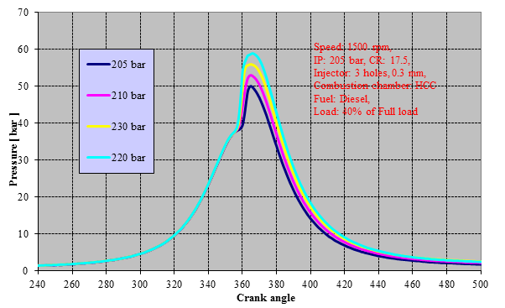
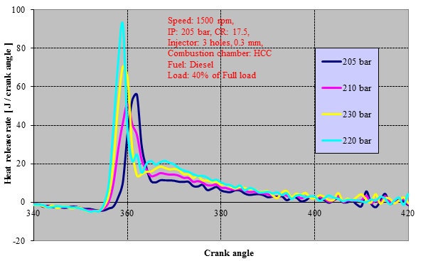
RESULTS (SAMPLE)
Fig 5.18: Variation of pressure with crank angle for
different injection pressure
Fig 5.19: Variation of heat release rate with crank angle for
different injection pressure
Mixture preparation during the ID period is responsible for the changes in peak pressure values and maximum increase of pressure rise.
Higher peak pressure was noticed with injector pressure of 220 bar when compared to other three IP and highest BTE was observed with the IP of 230 bar
The premixed burning phase associated with a high HRR is significant which is responsible for higher peak pressure.
This is the reason for the higher BTE of diesel with this injector at 220 bar
9 of 14

Slide 10
About the Institute
CONCLUSIONS
Have 1 or 2 number of slides
Preferably in Bullet Points

Slide 11
FUTURE SCOPE AND
INDUSTRY RELEVANCE
About the Institute
Have 1 or 2 number of slides
Preferably in Bullet Points

Slide 12
About the Institute
REFERENCES
Preferably the RECENT references
Have 1 or 2 number of Slides

Slide 13

REFERENCES

